Slide 1
Model Rockets vs NASA Rockets

Slide 2
Model Rocket
NASA Rocket
Long flight time
Very short flight time
Same forces
High speeds (on reentry) – heat is a big design consideration
Relatively low speeds – heat not typically an issue
Passive stability
Can use active control
Aerodynamics not as important
Aerodynamics very important
Same phases of flight
Liquid or solid propellant
Solid propellant
Looks cool!
Materials – cardboard, plastic, foam
Materials: Aluminum, titanium, nickel alloy
Notes:
Have students brainstorm first
Aerodynamics due to different time in atmospehre

Slide 3
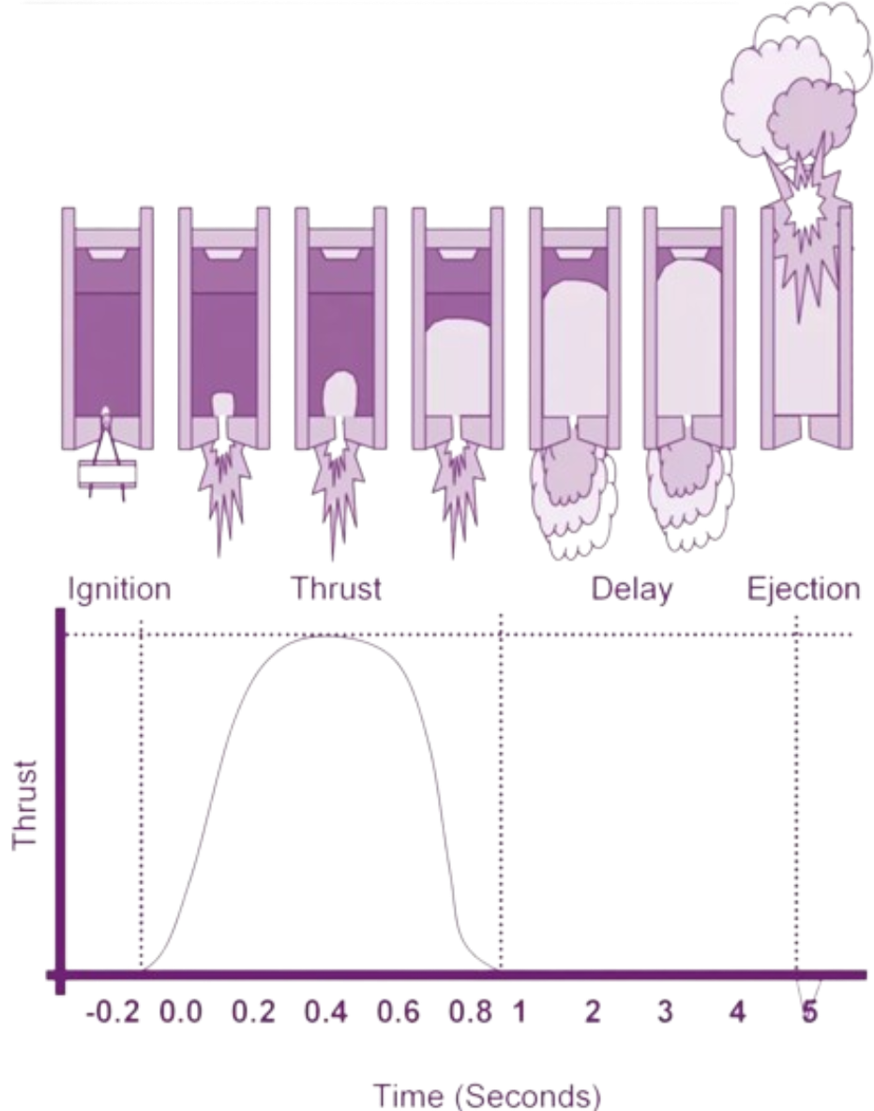
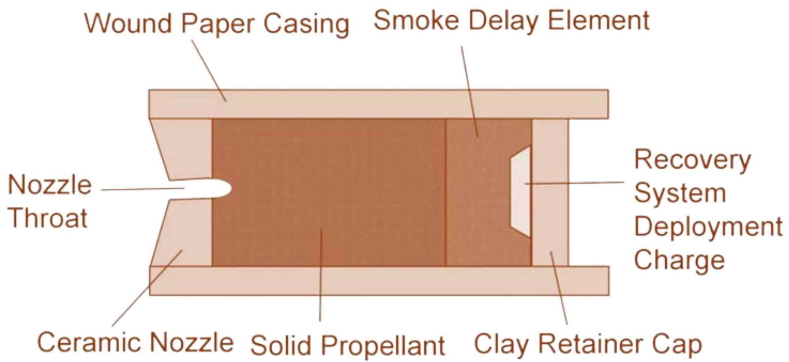
Model Rocket Engine

Slide 4
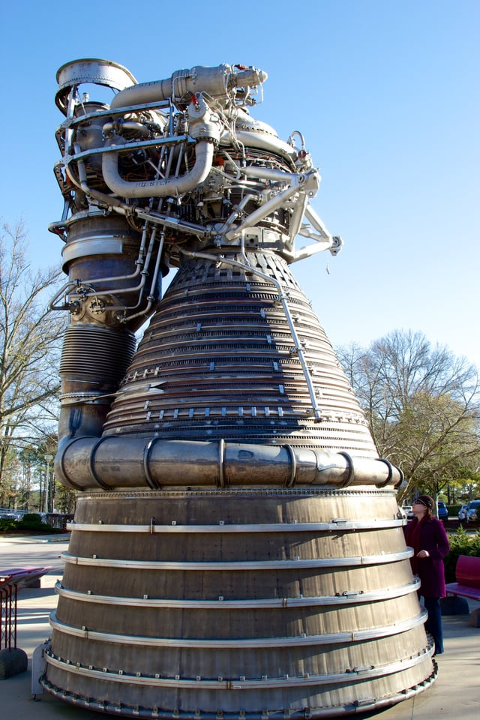
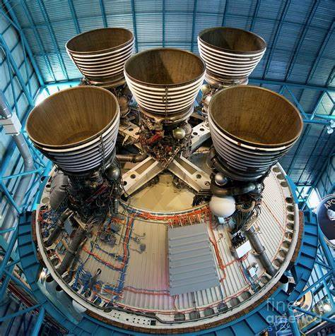
Saturn V Engines

Slide 5
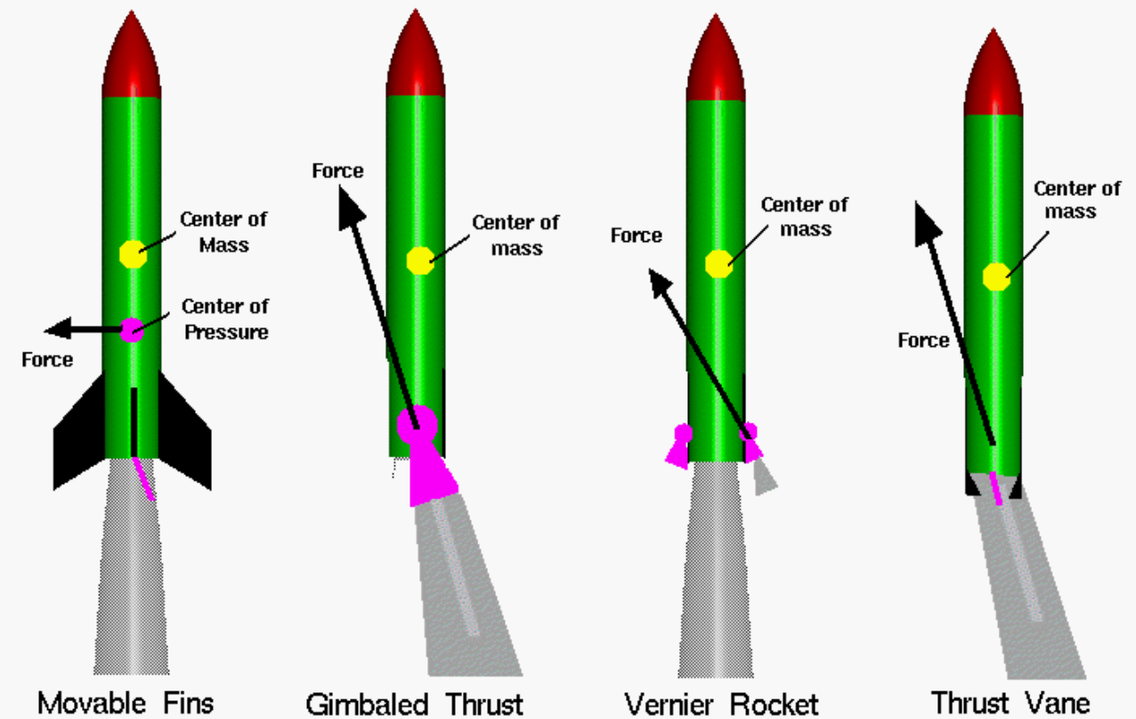
Active Control
Notes:
Talk about how 3rd law of motion is used here

Slide 6
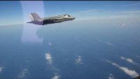
Thrust Vectoring in Action
Notes:
Review passive stability – CG vs CP, and why that’s not enough for NASA rockets
Talk about active Control

Slide 7
Problems at High Speed
Large Forces:
Bigger engines
Stronger airframes
Special design considerations
High Temperatures:
Special materials
Active cooling

Slide 8
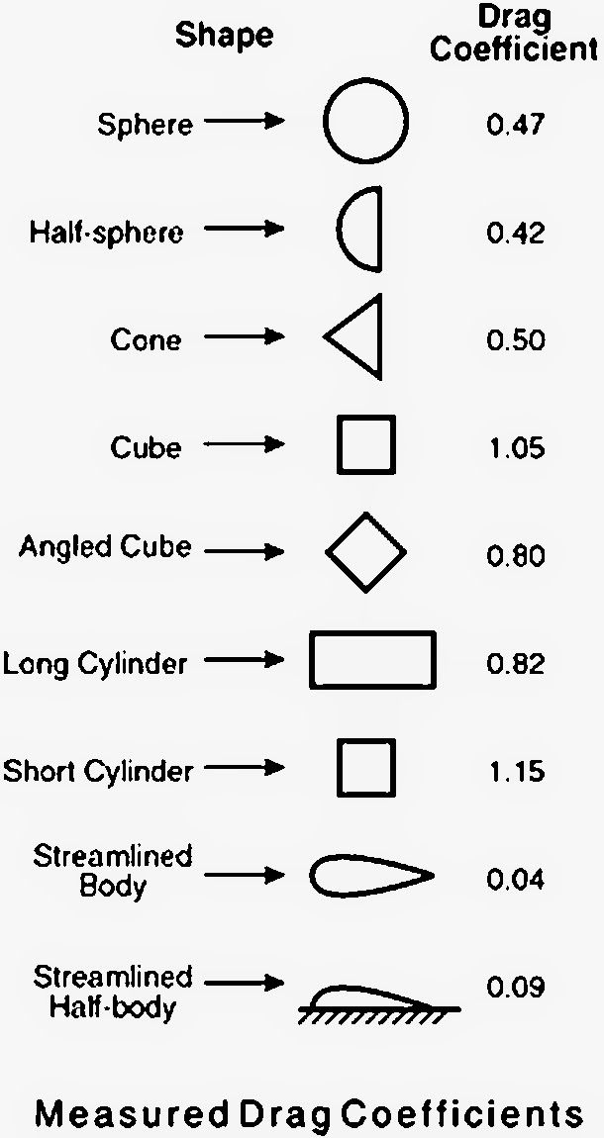
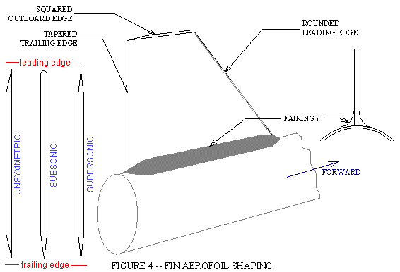
Aerodynamics
Notes:
Talk about why aerodynamics is less of a concern for NASA rockets compared to model rockets – NASA rockets have much more thrust, so can sacrifice some aerodynamics for other things. They also are in the atmosphere for a short amount of time compared to their entire flight time
However, the same aerodynamic principles still apply – use this picture as an example
However, both

Slide 9
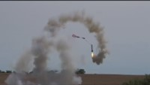
Model Rocketry Fails
Notes:
Beginning, 0:28, 3:05, 5:20, 5:42, 8:25

Slide 10

Space-X Fails

Slide 11
Space-X Design Philosophy
Falcon 9 cost per launch: $57 million
United Launch Alliance cost per launch: $380 million
More of a learn from experience approach to rocketry design
Utilizes a lot of help from NASA
Notes:
Should emphasize that NASA had a lot of failed launches in the beginning too, and that Space X is on the shoulder of giants

